Slide 1


Data 607 Final Project
Code Name: We-Showed-Up

Slide 2
Slide 9
Team Members
Zhi Ying Chen (Class Group #01)
Meng Qin Cai (Class Group #03)
Fan Xu (Class Group #04)
Sin Ying Wong (Class Group #04)

Slide 3
Can we find if there is any relationship between Airbnb, Walk Score, and Criminal Records in
New York City?

Slide 4
Work Flow
Airbnb
Walk Score
Data Source
Data Preparation
Data Cleaning & Consolidation
Analysis
&
Present
NYPD Arrest
Zipcode / Borough

Slide 5
Data Preparation
Where to collect data?
We want to know the relationship between Airbnb, Walk Score, and NYC Arrest Data
Collect data from Airbnb, Walk Score, and NYPD Arrest websites
How to collect data?
By excel file (.csv), web scraping, and API
What to do next?
Read data into RStudio to tidy them
Join the tables by using difference common information
Analyze and visualize them

Slide 6
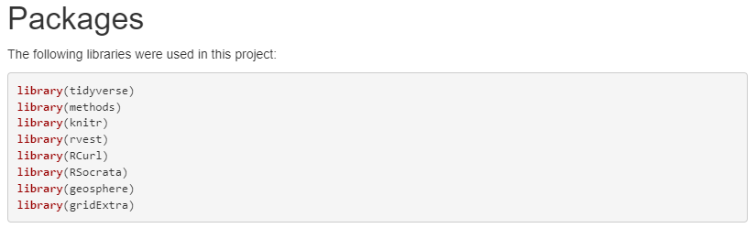
Libraries

Slide 7
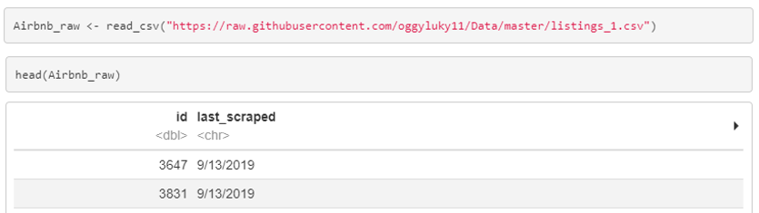
Data 1 – Inside Airbnb
Download directly
Excel file
New York City
Detailed Listing data
(http://insideairbnb.com/get-the-data.html)
Select Data for
year 2019

Slide 8
Data 2 – Walk Scores Web Scraping
Use distinct Borough and Zip Code data gathered from Inside Airbnb
Combine borough and zip code as input,
do Web Scraping
Walk Scores generated by borough and zip code
(https://www.walkscore.com/)
Key Words: “walk/score”, “transit/score”,
“bike/score”

Slide 9
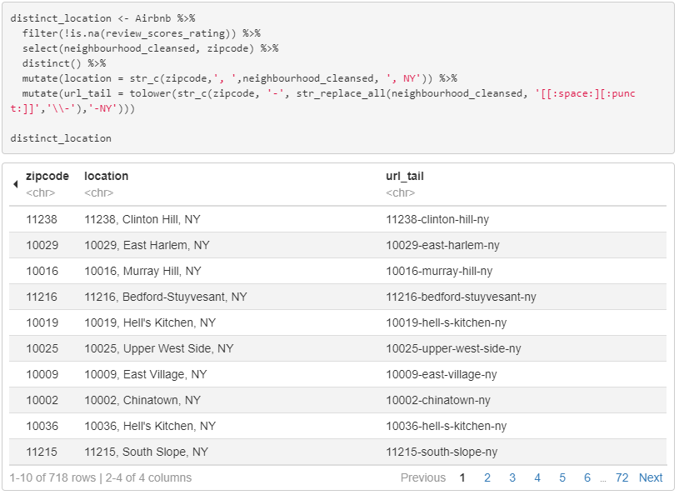
Web Scraping – 1. Combine borough and zip code

Slide 10
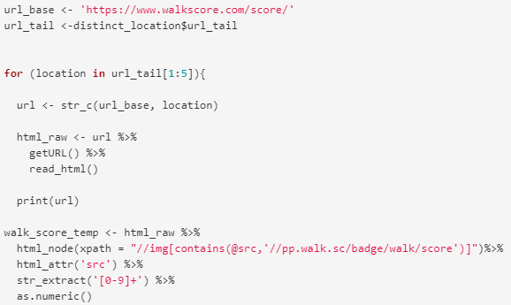
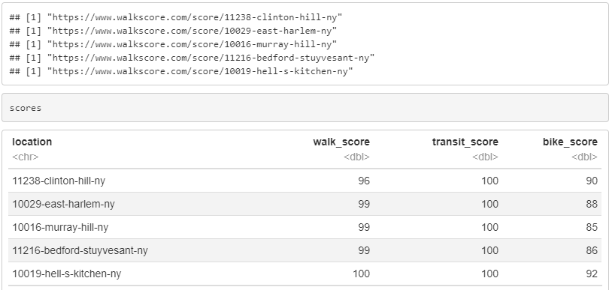
Web Scraping – 2. Use their link format to extract scores

Slide 11
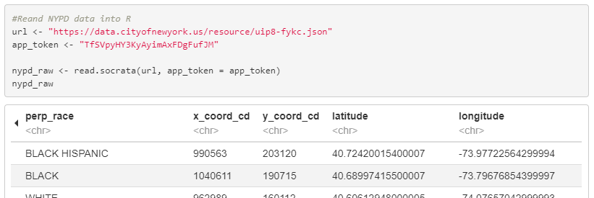
Data 3 – NYPD Arrest Open Data
Use API to access the database
Combine borough and zip code as input,
do Web Scraping
NYC Arrest Data
- Choose for year 2019
(https://data.cityofnewyork.us/Public-Safety/NYPD-Arrest-Data-Year-to-Date-/uip8-fykc)
Important Data:
Arrest Date,
Longitude,
Latitude

Slide 12
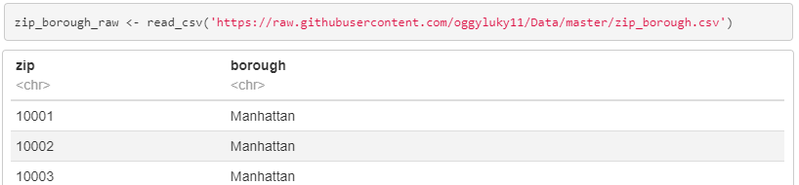
Data 4 – NYC Borough’s Zip Codes
Zip Codes <-> Borough
Airbnb Dataset does not have borough information
Kaggle Dataset
(https://www.kaggle.com/kimjinyoung/nyc-borough-zip)
Adding borough information into Airbnb dataset according to the zip codes

Slide 13
Data Consolidation – General
Prepare Data
Join Data Table
Remove NAs &
Select Columns
Data 1
Data 2
+
+
+
Data 3
Data 4

Slide 14
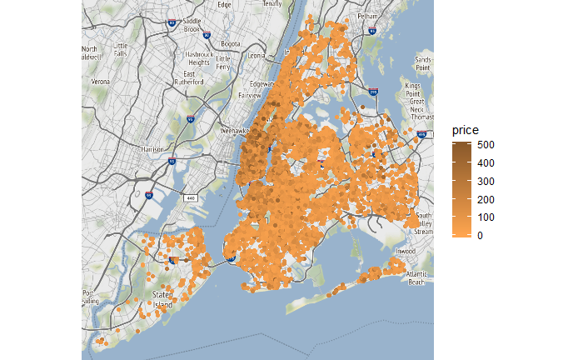
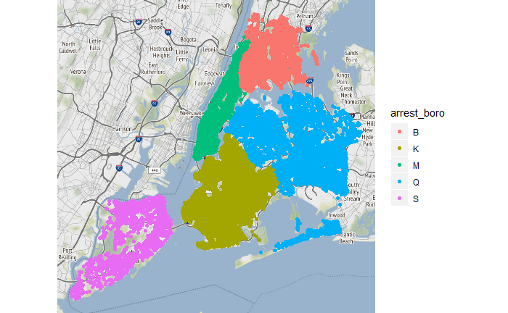
Data Consolidation – Challenge
Airbnb Data Table
NYPD Arrest Data Table
No general key ?
Need to establish connection between these two data tables
Hint: Does crime activities often occurred in specific Airbnb locations?

Slide 15




Data Consolidation – Solution
Compute the number of crime arrests within 0.5 mile of each Airbnb location, the more, the worse
Airbnb Location
0.5 Mile
Crime Arrest Location
0.5 Mile
Cnt = 0
Cnt = 4
0.5 Mile
0.5 Mile
Cnt = 2
0.5 Mile
Cnt = 1
Cnt = 2

Slide 16
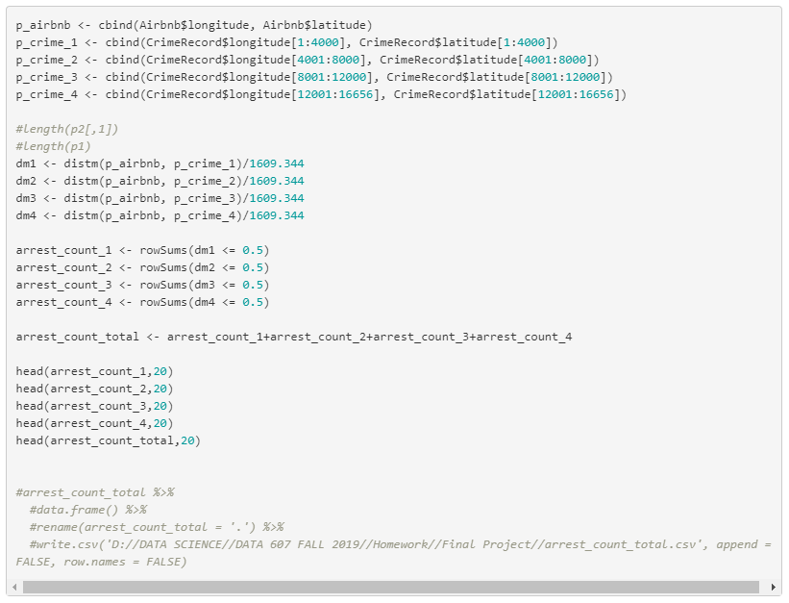
Data Consolidation – Process
Compute the number of crime arrests within 0.5 mile of each Airbnb location, the more, the worse
Use distm() function from [geosphere] package to compute the distance matrix of all Airbnb coordinates and crime arrest coordinates.
a. We have 40k+ Airbnb coordinates and 16K+ crime arrest coordinates. The matrix calculation is too large for R to handle.
b. Break the 40k x 16k distance matrix into 4 small matrices and compute the result separately.
c. Use rowSums() function to count the number of distance values that are less than 0.5.
d. Getting the count of crime arrests of each Airbnb location by sum up the results of the 4 small matrices

Slide 17
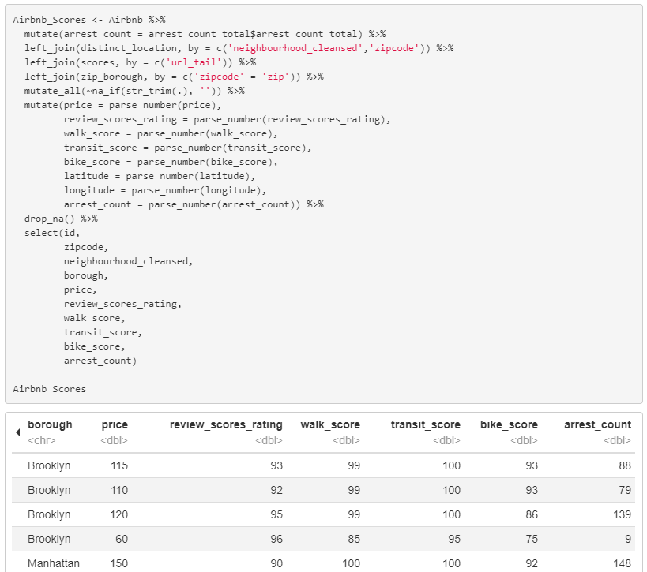
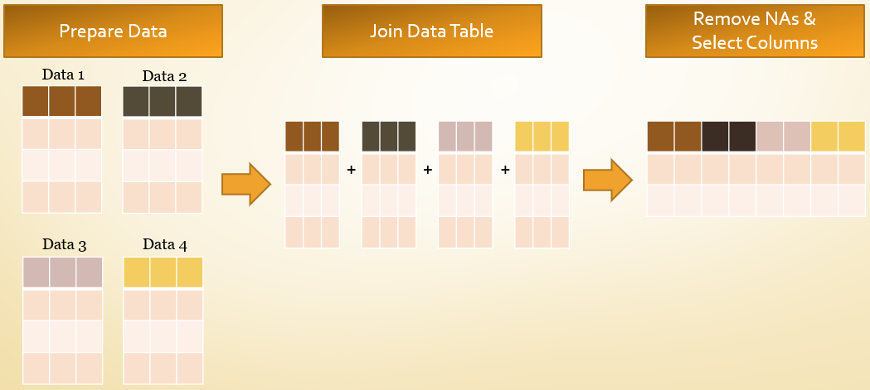
Data Consolidation – Combine Everything
Process Flow
a. Join all four dataset
b. Remove NAs
c. Select Columns that are needed

Slide 18
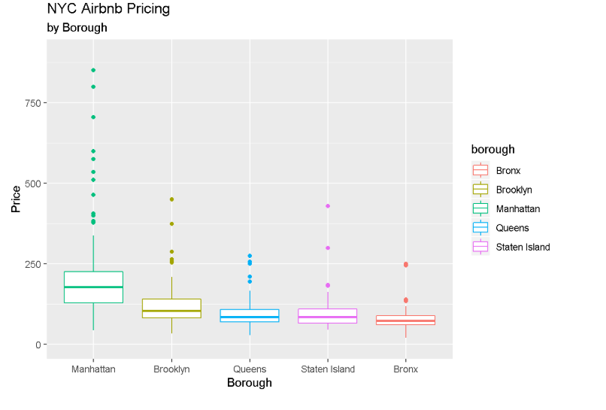
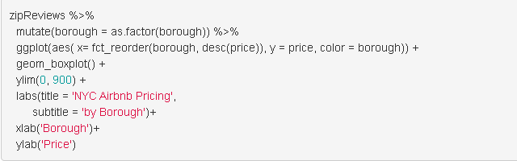
Analysis 1 – Pricing by Borough

Slide 19
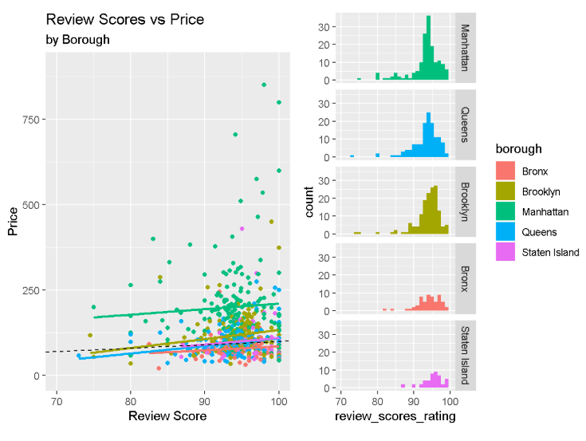
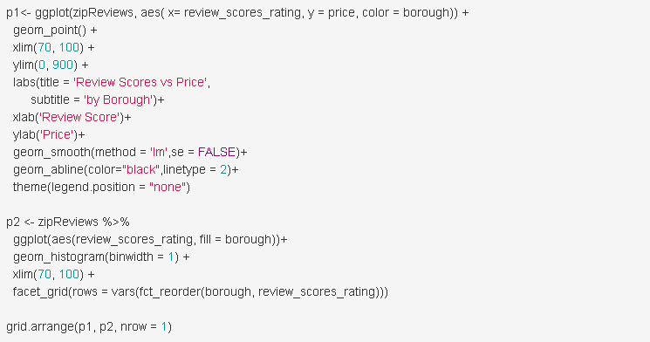
Analysis 2 – Review Scores vs Price

Slide 20
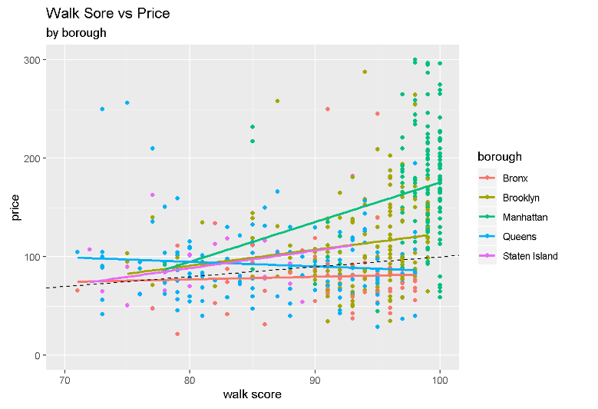
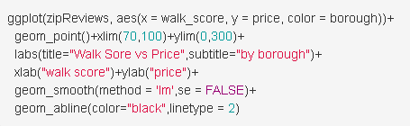
Analysis 3 – Walk Sore vs Price

Slide 21
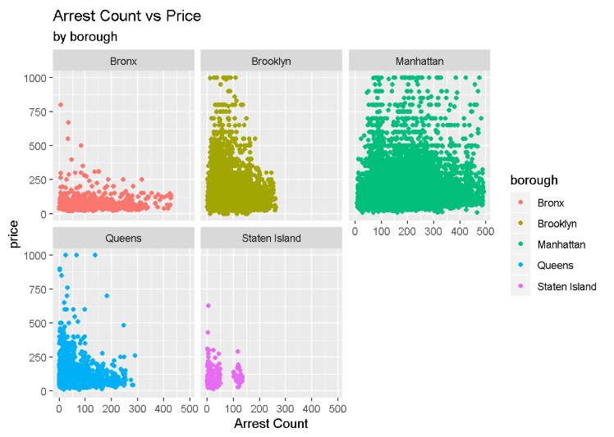
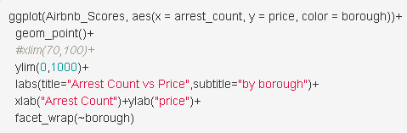
Analysis 4 – Criminal arrest count by Borough

Slide 22
Conclusion
We focused on investigating Airbnb’s pricing with other information on hand. We used review scores, walk scores, and arrest counts from the Airbnb dataset, walk scores, and criminal records.
Manhattan has the most expensive pricing on Airbnb among all five NYC boroughs. The higher the review scores of the Airbnb listings, the higher the price of them. On the other hand, the more than arrest counts within 0.5 mile from an Airbnb listing, the lower the set price of it.
However, there is no obvious relationship between walk score and Airbnb’s pricing. It may be because the transit is convenient in NYC. Besides walking, we also have subway, buses, free ferry and bikes. This study may have a different result if the location is set in a less condense and less commute-friendly city.

Slide 23
Thank You!

